Slide 1
Mondovi High School Class of 1967 50 Year Reunion
HOMECOMING 2017

Slide 2
Honored Guests
Mike and Betty Anderson
John Herpst
Janice and Steve Mikelson
Al and Donna Parker
Bob Stoughton
Others?
Letters …Mrs. Everson, Mr. Putzier

Slide 3
Carpe Diem Seize the Day
Remember….Ponder….
Pray…….Give Thanks

Slide 4
You Raise Me Up
When I am down, and, oh, my soul, so weary When troubles come, and my heart burdened be Then, I am still and wait here in the silence Until you come and sit awhile with me
You raise me up, so I can stand on mountains You raise me up to walk on stormy seas I am strong when I am on your shoulders You raise me up to more than I can be
You raise me up to more
than I can be.

Slide 5
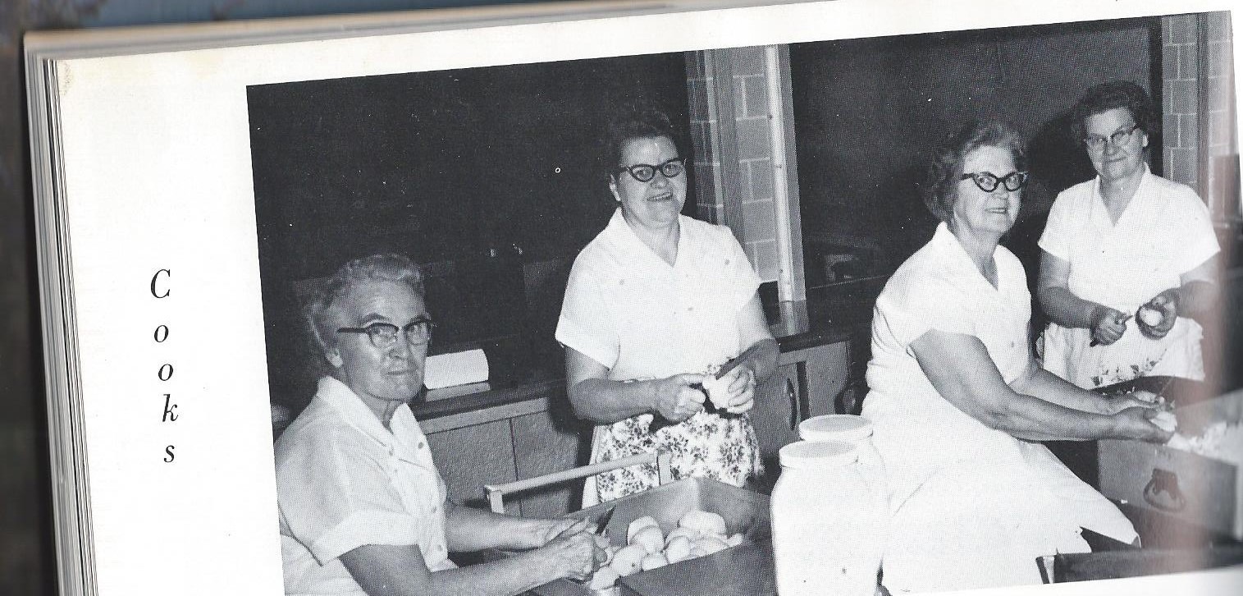
Quiz- 10 questions
1. Name one of these ladies.

Slide 6
2. Other names for Mondovi before it incorporated:

Slide 7
3. What year did Mondovi become incorporated?

Slide 8
4. Name of either of our classmates who retired from the City of Mondovi in 2012 & 2015….(total of 67 years)

Slide 9
5. What was the name of the Trophy our band won at the Wisconsin State Fair?

Slide 10
6. Who is the Wisconsin Supreme Court Justice whose picture is on the Alumni Wall at the High School?

Slide 11
7. Who were the alumni inducted into the Hall of Fame this Friday?

Slide 12
8. How many of our classmates served in the military?
Or name a classmate who has been active in the American Legion Auxilliary since 1972.

Slide 13
9. What Pastor spoke at our 1967 Baccalaureate Service?
Bonus:

Slide 14
Who said
“In a time of tradgedy, LOOK FOR THE HELPERS; there are always helpers.”

Slide 15
1. Mrs. Schultz, Mrs. Paulson, Mrs. Severson and Mrs. Mahlum
Pancake Valley or Farrington’s
1855
Jimmy Marsolek 1975-2015, Allen Schwartz 1985-2012
Governor Knowles Trophy
Honorable Justice Grover Broadfoot
Ruth Christopherson and Sandra Mahlum Haidvogel
10? Terry Crawford Stiner
Rev. Harold Haugland..”One World, One Mess, One Answer”
Fred Rogers…It is a beautiful day in the neighborhood.

Slide 16
Cheer, cheer, Mondovi’s the name, Victory with honor that is our aim. Raise her colers, wave them high, Shake down the thunder from the sky. What though the game be hard or long, You’ll always hear us singing our song. While our loyal sons and daughters March on to victory.

Slide 17
Hail to the blue and the white, Let’s play this game with all of our might. Raise her banners, wave them high, Flashing their colors in the sky, What though the odds be great or small, Mondovi High will win over all. Ever loyal sons are fighting, Onward to victory.

Slide 18
Climb Every Mountain
Climb every mountain, search high and low, follow every byway, every path you know.
Climb every mountain , ford every stream, follow every rainbow, till you find your dream. (This sentence repeats.)
A dream that will need all the love you can give, every day of your life for as long as you live.

